Slide 1

INTRODUCTION TO
PI LOAN APP

Slide 2
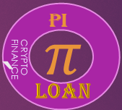
PI LOAN APP
This is a loan application that aids the entire sub world to have access to crypto currency finance called pi coin

Slide 3
LOAN BASED ON BLOCKCHAIN TECHNOLOGY
SECURED CRYPTO CURENCY
BLOKCHAIN MATRIX

Slide 4
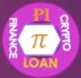
This application can be downloaded from app stores of mobile devices, while rooted to the inherent domain source called Pi Browser.

Slide 5





FINANCE PI CHART
$$π$$
PENALTIES
$$π$$
INACTIVE
$$π$$
CORE TEAM
PIONEERS
$$π$$
$$π$$

Slide 6

PI LOAN FINANCE SOURCES
$$π$$
1 PI CORE TEAM : Sugested to contribute 50- 59% for initiating
purpose.
2 PIONEERS : To contribute 20-23% for initial reasons
(to increase per time).
3 INACTIVE WALLETS: To contribute 10%.
PENALTY WALLETS To contribute pending period of lifting.

Slide 7

$π$LOAN STAKE AND BENEFIT SCALES
Staking power
Profit in 3yrs
30%
20%
15%
Elasticity
10%
25%

Slide 8
PI LOAN APPLICATION PROCESS
There shall be a query form to be completed by the loan applicant, which will be verified and authenticated before disbursement of pi coin as loan.
*Secured confirmation of persons/organizatios shall include;
Website age,
Number of followership on social media apps,
Website email contact confirmation,
Applicant’s email link recomfirmation
Face verification,
Document uploads,
Existing crypto swap to pi and locks,
Collaterals
Pioneer staked volume

Slide 9
HOW TO APPLY FOR PI LOAN
Pi loan app has its domain in the Pi Browser where app and loans are asseccible to legitimate pioneers with pi wallets.
Pi loan app is also availible in mobile app stores for user who are non-pioneers.
Pi Core team would approve the loan through affiliated, off ecosystem Banks

Slide 10

$π$ LOAN ELIGIBILITY /CATEGORY CHAT
Stable Economic
Under Developed
NATIONS
Developing
INDUSTRIES
Sports Clubs/Entertainment
Large Scaled
Manufacturing Engineering
Internet Trade Mark
BANKS
International Graded
Commercial
Swapable AltCoin Holders
PIONEERS
PIONEERS with 1-2yrs stake
PIONEERS with 3yrs stake

Slide 11
IMPORTANT NOTE TO PI CORE TEAM
We must systematically induce our intellectual impulses to the pioneers who are altcoin converters by making the usefull Dapp utilities, proactive in the ecosystem.
Though Pi coin being convertible at any point, our app inpacts can encourage 90% Altcoin to pi conversions instead of its reverse action.
Take example of a nation’s economi treasures, being looted gradually by it’s compatroits to other nations. By so doing, still call the looted tresures their’s, but have practically funded the other nations for spontaneous and rapid developement, which adverse effect render own economy incapacitated. Again have discouraged genrational developement of their nation.
They looted it away, now its government always tend to borrow from the custodial nations
‘knnamdi1’in Golden Pen

Slide 12
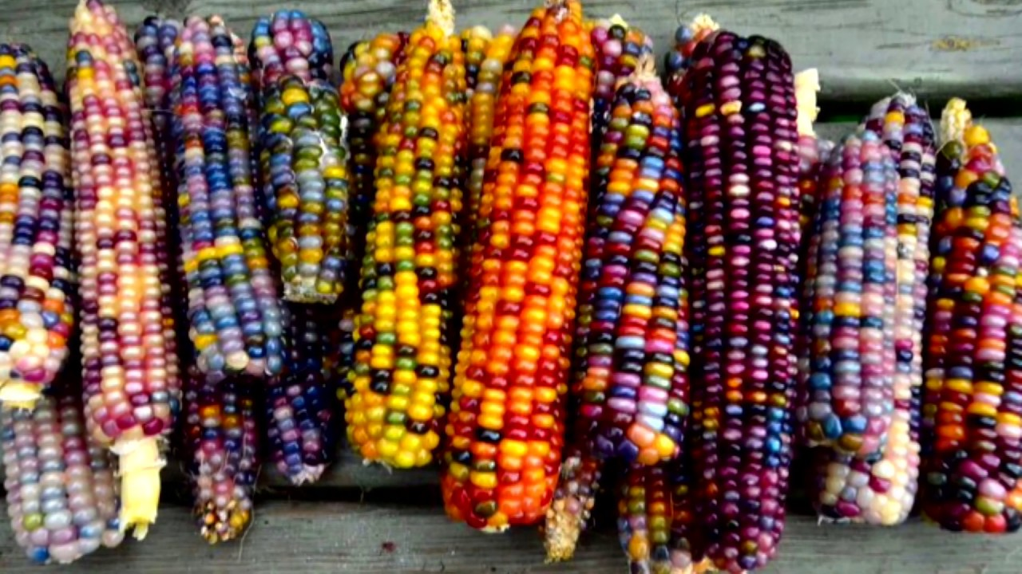


PL APP DEVELOPER REMARKS
$$π$$
After i joined Pi network, i encouraged new pioneers in the brainstorm chat room, who were eger and inquisitive about price of picoin and lunch date, to keep mining pi. That what we are mining looks like black gold yet to be known to the world.
But the diagram beside from my disovery, is what we are giving out to wise farmers (Investors). It is a bunch block of first ever, specie of crypto corn, different from others. You crop a seed, it yeilds to other corn bunch which is continually regenerational. The farmer has the potential to multiply, florish and spread out.
Moreover, he would gladly make returns in bunches and seedlings (Loan amount + interests) Here i could call it ‘pi corn network’.
THE PI LOAN FINANCE SYSTEM IS THE HOSPITAL THAT WOULD RESORCITATE AND HEAL THE WORLD ECONOMIC FINANCE INEQUALITIES
USER NAME
knnamd1
https://piloanworld.com
pi://brainstorm.pi/project/63b328f9328b
Email:knnamdi1@gmail.com
APP LOGO

Slide 13


$$π PI LOAN APP$$
THANKS TO THE PI CORE TEAM FOR THE OPPOTUNITY TO IN CRYPTO SPACE AND AN APP DEVELOPER IN PI HACKTHON 2.
I APPRECIATE ALL VIEWERS

